Slide 1
BADM 590 – Big Data Infrastructure
Innova Cloud Inc.
Amazon Web Services
Cloud Native Analytical Platform
Powered By
amazon

Slide 2






Team Members
Tejas Dhomne
Vineesha Devati
Fengze Han
Wangzhen Yu
Xiaoyang Juan
Shradha Tiwari

Slide 3
01
Business Overview
02
Product Overview
03
Target Market
04
Model Schema
Contents
05
AWS Services
06
SWOT
07
Revenue and Cost
08
Analytics Applications
09
Conclusion and Improvements

Slide 4

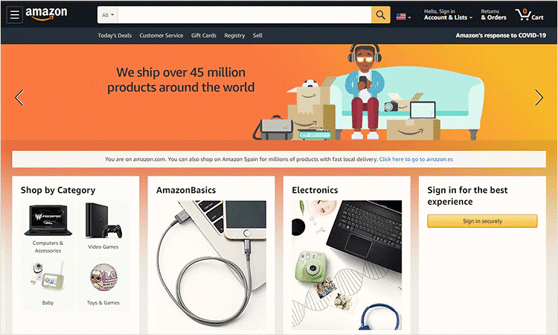
Business-Overview
Retail analysis is the process of gathering data from different sources that impact a certain store in sales.
This data can be used to predict changes in the client behavior and online purchasing habits.
Retail analytics encompasses the whole customer journey, from discovery to acquisition, conversion, retention, and support.

Slide 5





Business Problems
Data comes from several batch and streaming sources.
The incoming data is massive and makes it hard to store.
Traditional system can fail to compute and deliver in real time speeds.
Customer data needs to be secure and safe from manipulations.
VARIETY
VOLUME
VELOCITY
VERACITY

Slide 6
FEATURING !
AWS
Cloud Native Analytical Pipeline
One Platform - Multiple Solutions

Slide 7

Product Description
Product provides an affordable, easy-to-use service for better operation of successful deliveries/purchases and a delightful customer experience for the growth of retail businesses
A real-time scalable product that enables a faster intelligent decision-making process
Delivers key insights to answer specific business problems based on brand popularity, purchase behaviors, and customer details
Eliminating the latency gap between data engineering and business analysis through processing real-time data and extracting timely insights

Slide 8

Product Values & Goals
Real-Time Processing
Data Integration
The time-sensitive data is processed immediately in real-time to eliminate delays in operations for a positive customer experience
Simulate NRT (Near-real time) streams and schedule bulk or batch
Lake House and Stream Design
Scalability
The scalability of the service enables businesses to store millions of records in a database considering the change in volume of data based on seasonality or long weekends for timely delivery of the item/product
A new Lake House architecture including Batch and NRT layers
Cloud
Uses Amazon Web Services as a cloud provider
Log Simulation
Batch Processing
Product helps to solve key business questions by simulating the logs of user purchases, product views, cart history, and the user’s journey
Batch data processing can be done for the historical data to gain impactful business insights to optimize the item/product delivery process for the business

Slide 9

Target Market
Main Competitors
Target Area
Kofana, Salesforce
and SAP Sales Cloud
Who are dominating the market for cloud-based business intelligence services
United States
The region that has the biggest market share in the retail sector.
Consumers
Retail Businesses
Who expect to have a faster intelligent decision-making process.

Slide 10
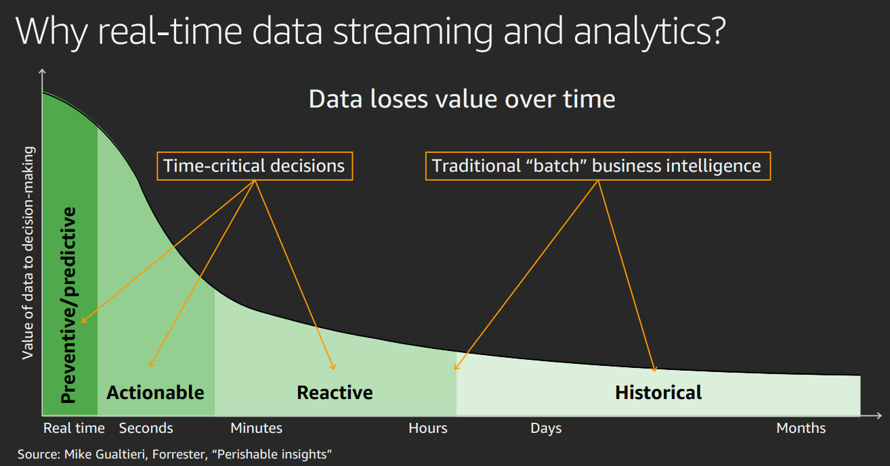

Slide 11
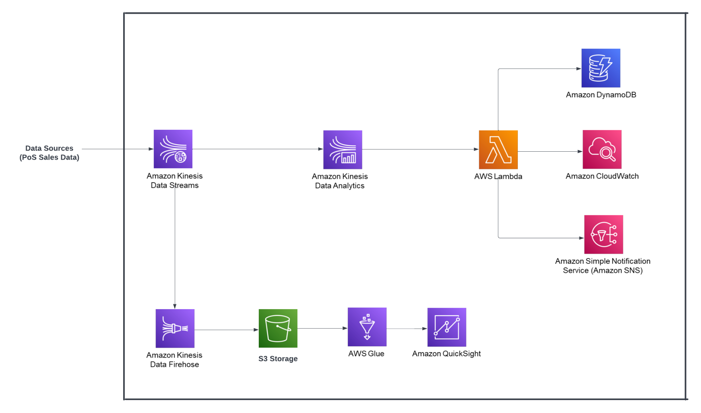
AWS Service Schema
Lucid Chart:
https://lucid.app/lucidchart/947c2f5a-e4e6-427a-8674-385a29926a48/edit?viewport_loc=-144%2C-90%2C3330%2C1557%2C0_0&invitationId=inv_37748d2e-63f2-4b0f-b4c2-908022ea6299

Slide 12
Analytics using AWS
AMAZON Kinesis
Amazon Glue and QuickSight
AWS Lambda and SNS
Amazon Dynamodb
Streaming data can be collected using Kinesis Data streams and AWS Kinesis Data Firehose transforms the required data before delivering it at real-time.
Lambda triggers the function automatically and sends it to SNS and AWS Dynamodb. SNS delivers messages from retailers to customers regarding discounts and offers.
Dynamodb is a NOSQL database which delivers quick results while fetching high volume unstructured data and can be used for data backups.
Glue performs ETL operations on the data at a nominal cost without using other infrastructure and makes it ready for analytics. This data is then sent to AWS QuickSight to obtain visual insights and interactive dashboards
Data Collection
And Stream Analysis
Batch Analysis
Triggers
Querying

Slide 13
SWOT
S
Efficient data pipeline that includes techniques for transferring data from one system to another
Data pipelines include ingesting data using various methods, storing raw data, cleaning, validating and transforming data.
Strength
W
There are some limitations on acquiring data resources consisting of purchase records of the consumers.
Weakness
O
As the retail cloud industry grows rapidly, this service will likely be in high demand
There are many beneficial aspects for our customers, such as Cloud Scaling and integration with third-party applications.
Opportunities
T
Organizations find it challenging to guarantee that data is only accessible to authorized parties in cloud infrastructure.
A security breach can result in data leaks and release of personal information.
Threats

Slide 14
Membership Fees
As a membership and subscription based SaaS business, our products will be charged weekly, monthly or annual membership fees.
Monitor Metrics
Revenue from membership fees, Gross Sale Revenue, each period prices (weekly, monthly, and annual) * number of customers in corresponding period, is a good metric to measure.
REVENUE
Other Mechanism
The estimation of the quantity of new clients we will gain over time is the first stage in creating our revenue model. We can divide them into 3 different subscription options once we know how many additional clients we will bring on board.
5 Years Growth
We can compute the growth rates by using either of the five strategies such as Monetization, Moving into new market, Moving downmarket and the upmarket or Product expansion.

Slide 15
Marketing Expense
Pay a marketing team to help us advertise and find potential customers.
AWS Service Fees
Pay AWS a certain amount of money to use their services.
05
01
COST
04
Infrastructure cost
Renting office space, purchasing office supplies and related electronics.
Personnel cost
Hire engineers to build our model, web pages or computer programs, and design an easy-to-use and attractive user interface(UI). Also Hire operators to monitor and iterate our service.
02
03
Attorney fee
Attorney fees are paid to attorneys who provide us with legal services, such as drafting contracts with clients.

Slide 16


Analytics Application
Customer analysis to enhance the features and gain insights which lines with the user needs and boosts sales for the grocers.
Analysis on the product will give us information about the consumer behaviour and guides us in making further decisions.
Analytics on the sales data and customer data is a vital source for this product to increase the sales, we need to understand the customer shopping patterns, festival shopping patterns and most purchased items.
Targeting, which would incorporate behavioral factors (recent activity, category clusters), derived factors (transaction data, propensity models), and demographic factors (gender, geography, consumer/business)
Notes:
Customer analysis help our customer gain insights and boosts sales for the grocers.
Product Analysis guides our customer in making the best decision
sales data and customer data Analytics will help our customer understand the customer based on different feature to increase the sales

Slide 17
CONCLUSION
Our product is Cloud-Native Analytical Pipeline, which provides retail businesses with a faster intelligent decision-making process by processing real-time data and extracting timely insights, eliminating delays between data and business.
Our products process historical data, such as purchase records, product views, shopping cart history, etc., to gain influential business insights to optimize the business's project/product delivery process. Help solve critical business problems.
Our team not only focuses on improving the core competitiveness of our products, but also attaches great importance to improving the user experience.

Slide 18

Future Improvements
Use AI to enhance the data analysis capabilities of our products.
Design our software products to improve productivity and efficiency.
Partnering with big name companies and e-commerce platforms, increase our exposure, visibility, and credibility.
Notes:
Artificial intelligence make it possible to link data to gain insights on customers, grow the business, and optimize the speed and quality of logistics. We also want to integrate such tools to navigate the business
When our product is mature enough and we have long-term customers. We will try to develop our own software to help our product more productive and efficient.

Slide 19
thanks!

